Slide 1
5

Slide 3
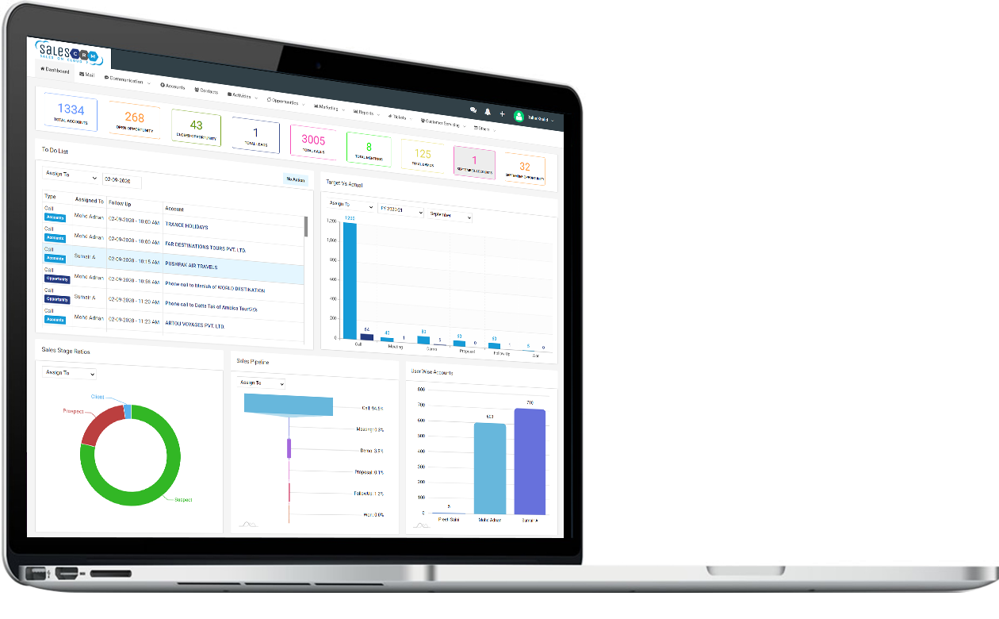
DASHBOARD
To Do List is the most important functionality of the Dashboard in which all the scheduled activities are displayed and if they are not performed on time then they are highlighted with colored background.
Buckets on the top helps in immediately categorizing the data into various stages.
Indicates Target vs Actual Activities across all sales executives.
Charts like Stage wise Sales Funnel, Distribution of Accounts and Categorization of Accounts makes the Dashboard expedient.
WWW.DEBOXGLOBAL.COM

Slide 4
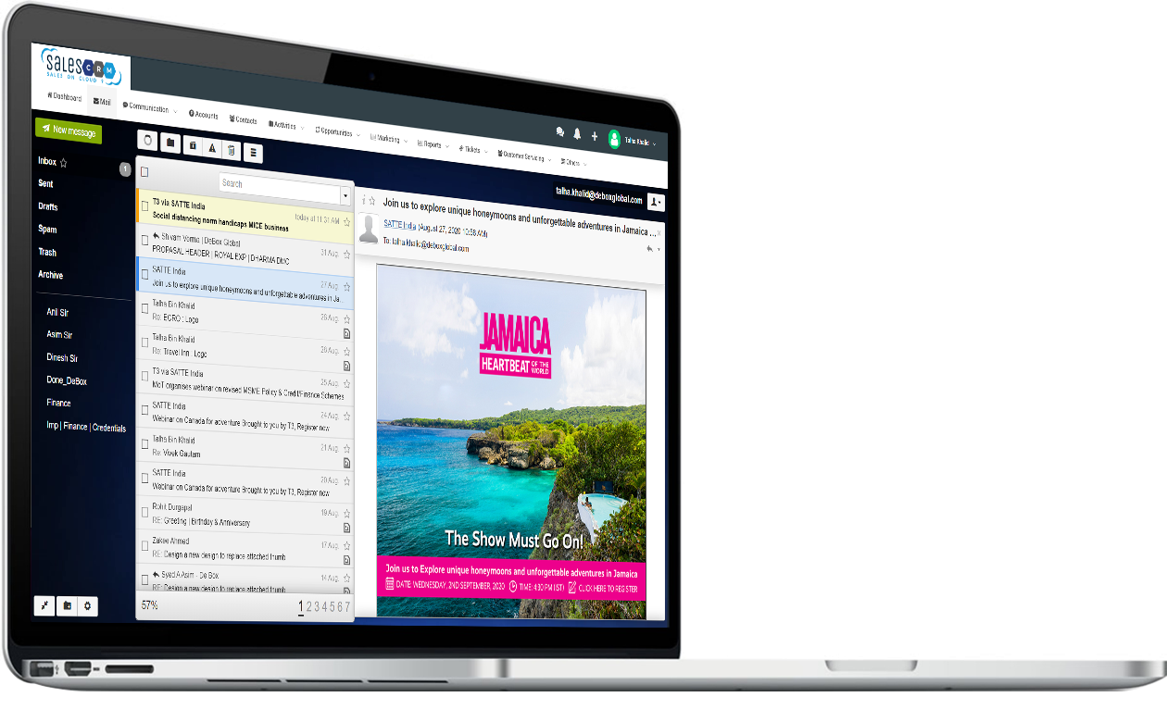
MAIL
Email Integration enhances the utility of the product by letting users do direct communication from the CRM.
Email Integration enables auto sending of mail to customers for sending Product Information as per Pre Specified Templates, Online Demo Credentials, Demo Feedback Form, Proposals, Invoices, etc.
Saves time and effort of Sales Executives by Auto filling Contact Details of each prospect and loading from relevant templates instead to drafting them every time.
WWW.DEBOXGLOBAL.COM

Slide 5
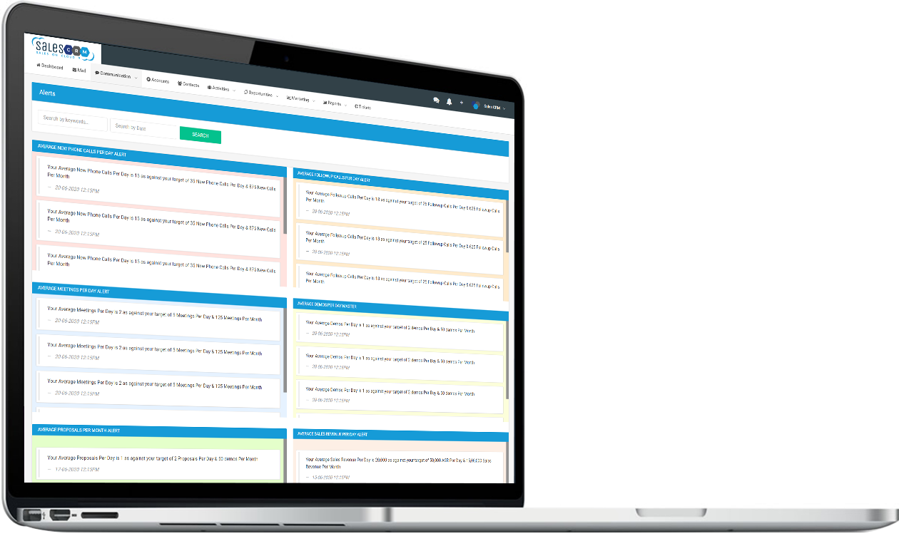
ALERTS
Alerts helps in highlighting the non compliances of the expected goals.
It reduces the efforts of monitoring the desired results and only focus on areas of concern.
Notifications allows seamless flow of coated information to the different users of the CRM.
New product launches, important instructions, general awareness about company's progress, Industry news, company ads, internal or external events, Mc. can be notified to the users from time to time.
WWW.DEBOXGLOBAL.COM

Slide 6
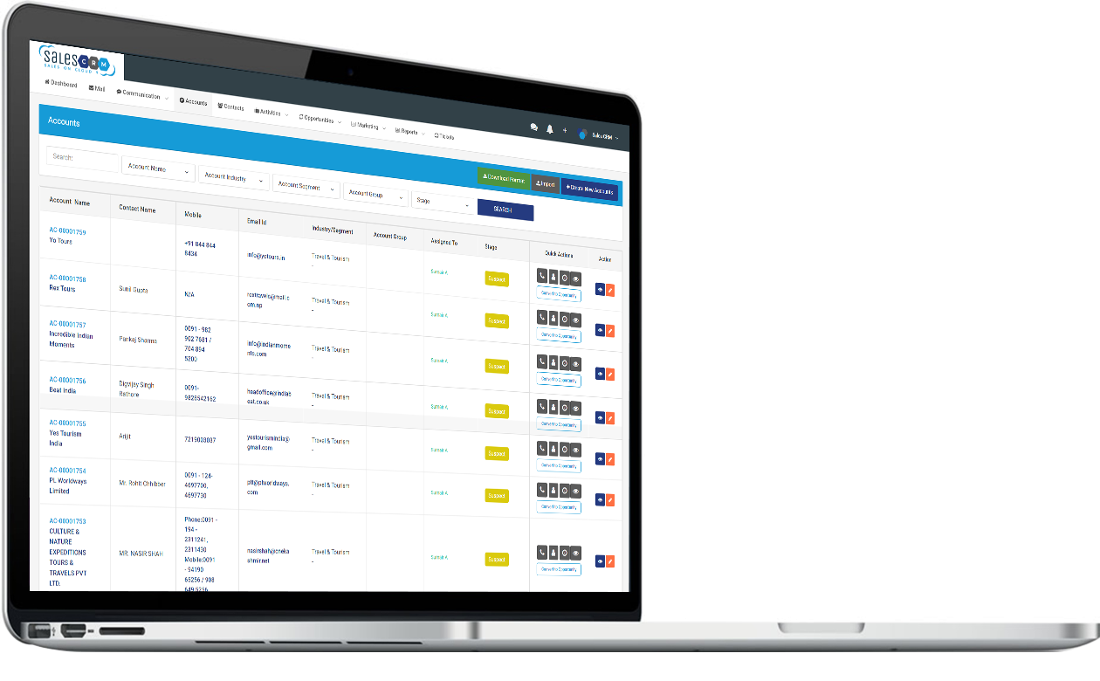
ACCOUNTS
Accounts indicates the Sales Database of the company consisting of Suspects, Prospects and Clients.
Accounts view allows Categorizing and Grouping the prospect companies' data and allocating to different Sales Executives for carrying out sales activities on it.
Quick Action Menu in Accounts captures sales activities in minimum clicks.
Accounts captures Company's Contact details, Industry, Area of Ops, Bank details, Document details, etc.
WWW.DEBOXGLOBAL.COM

Slide 7
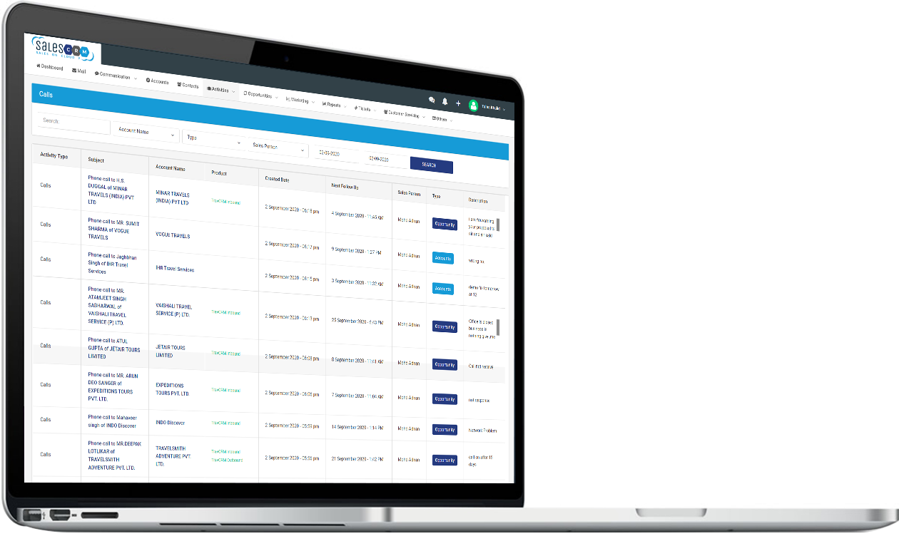
ATIVITIES
Sales Acti0ffes are liked to Accounts and Opportunities to make it easy for users to record them.
Scheduled Activities or Follow up Activities are shown in To Do List of the User on the specified Date & Time.
Activities include Phone Calls, Meetings, Demos and Other Tasks as defined in the CRM.
Log of Activities done for any Account or Opportunity is recorded date-wise.
Client feedback regarding Demo is recorded and displayed as cumulative chart as well.
WWW.DEBOXGLOBAL.COM

Slide 8
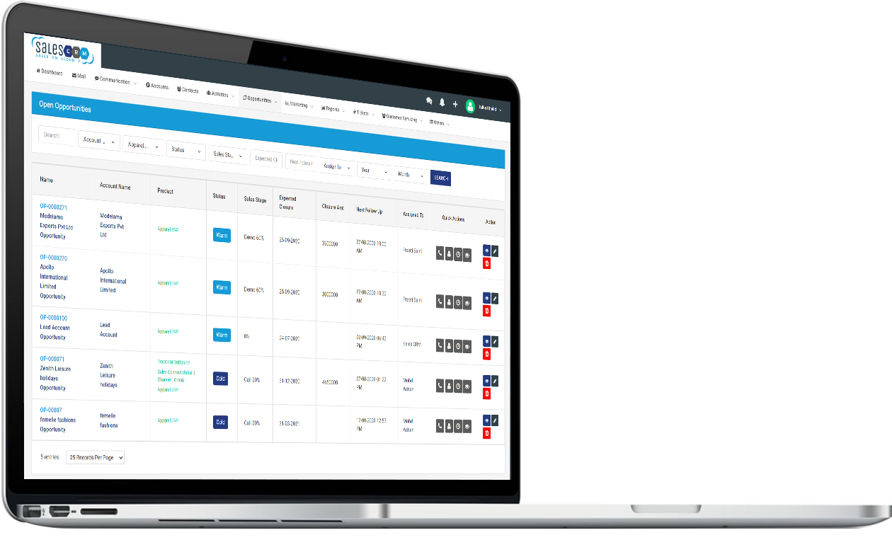
OPEN OPPORTUNITIES
Opportunities are created when Accounts are validated by Sales Executives and found potential in it.
Once product / service wise Opportunity is created in any Account then its status changes automatically from Suspect to Prospect.
Working on Opportunity Stages leads to generation of Sales Pipeline and Month wise Projection.
Opportunities results into Closures, either by Winning a deal or by Losing it. Won Deals are automatically converted from Prospects to Clients.
WWW.DEBOXGLOBAL.COM

Slide 9
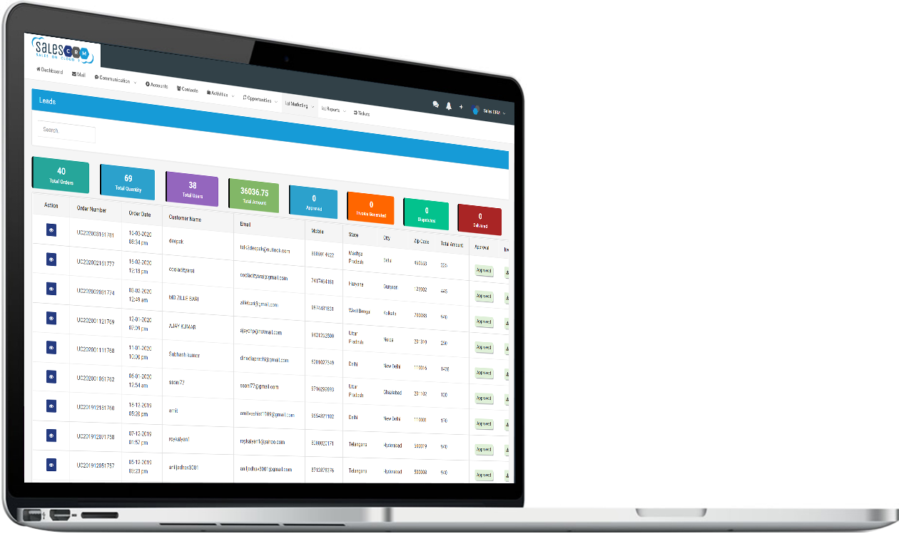
LEADS
Marketing Module covers Campaigns, Leads and Marketing Activities.
Campaign Planning covers setting goals and then comparing it with actual results.
Leads can be fed manually or integrated with webs,. or social media through landing page.
Marketing Activities captures the activities done by digital marketing executives on each campaign of the company.
WWW.DEBOXGLOBAL.COM

Slide 10
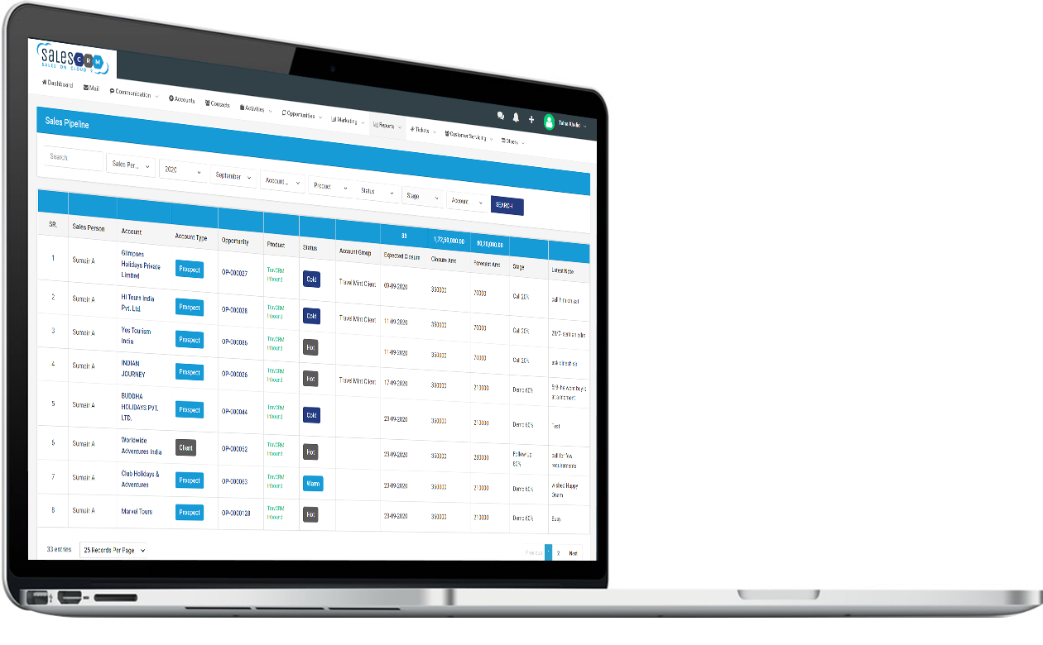
REPORTS
Reports covers Daily Activity Report, Sales Pipeline, Business Forecast, Customer Servicing Reports, Pending Payments, etc.
Additional reports are on the basis of customized requirement of each client.
Ticket Report tracks the ticket resolution process and aging of each issue raised.
Ticket Dashboard gives the graphical view of resource wise ticket allocation and their resolutions.
WWW.DEBOXGLOBAL.COM

Slide 11
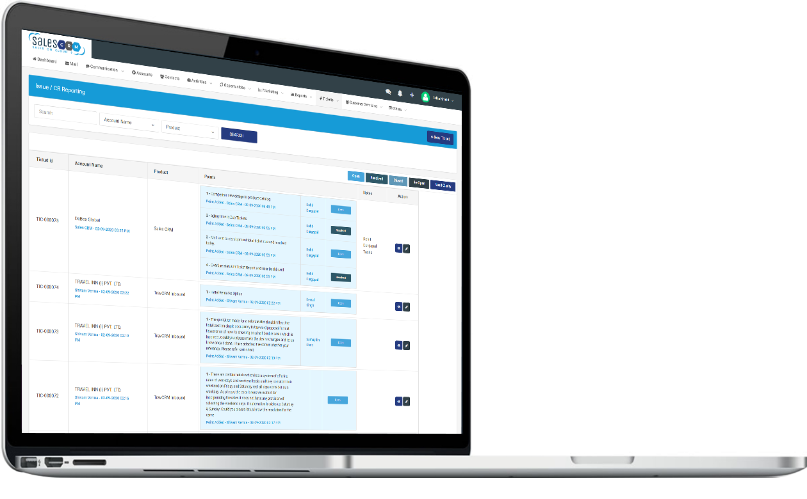
TICKETS
Comprehensive Ticket Module covers Entire Life Cycle of Issues and Requirements.
Tickets gets assigned to Operations / Development Team and they can address the issues and requirements raised on behalf of the clients.
Complete flow of Ticket resolution is captured in the CRM and live status can be viewed anytime.
Access of the module can also be given to the clients to create tickets and see the progress of resolution.
WWW.DEBOXGLOBAL.COM

Slide 12
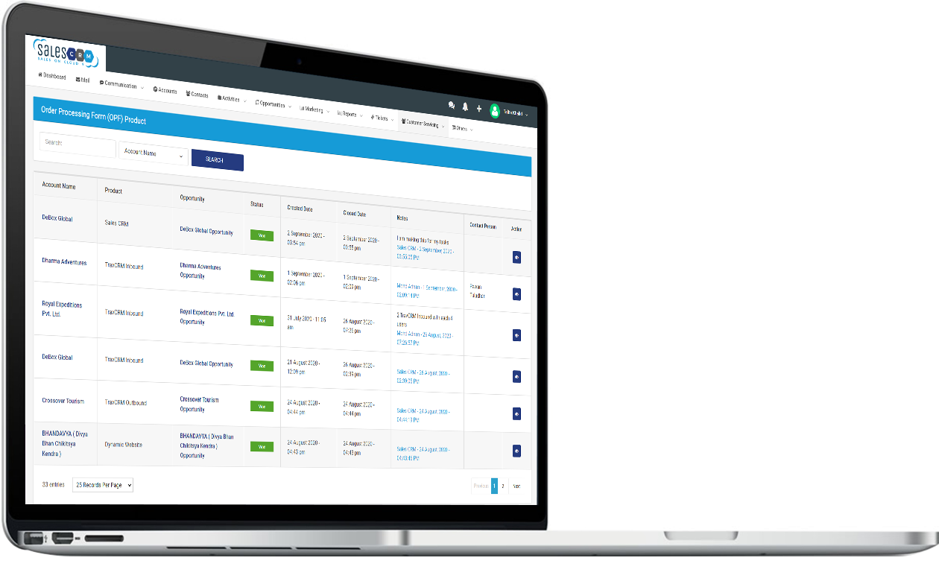
CUSTOMER SERVICE
Post Order Customer Servicing Module helps in allocating work to each department for fulfilment of the order.
Order Processing Form is generated by the system for Operations to process the order and Accounts to generate Proforma Invoice or Invoice for the client.
Sales CRM records the collection of payments against each Invoice and provides the pending payment status.
Purchase Order / Order Confirmation Management is also part of this module.
WWW.DEBOXGLOBAL.COM

Slide 13
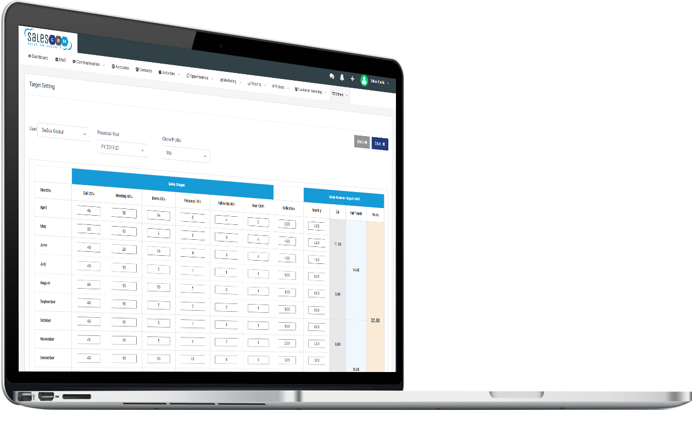
TARGET SETTING
Target Setting is based on multiple parameters such as Effort Based and Result Based Targets.
Targets can be set for each Sales Executive across all given parameters for different time periods namely: Monthly, Quarterly, Half Yearly and Yearly.
Financial Year wise targets can be set for each Sales Executive and then cloned and modified for the nerd financial year.
These Targets are compared with Actual Achievements and shown in Dashboard, Reports and Alerts.
WWW.DEBOXGLOBAL.COM

Slide 14
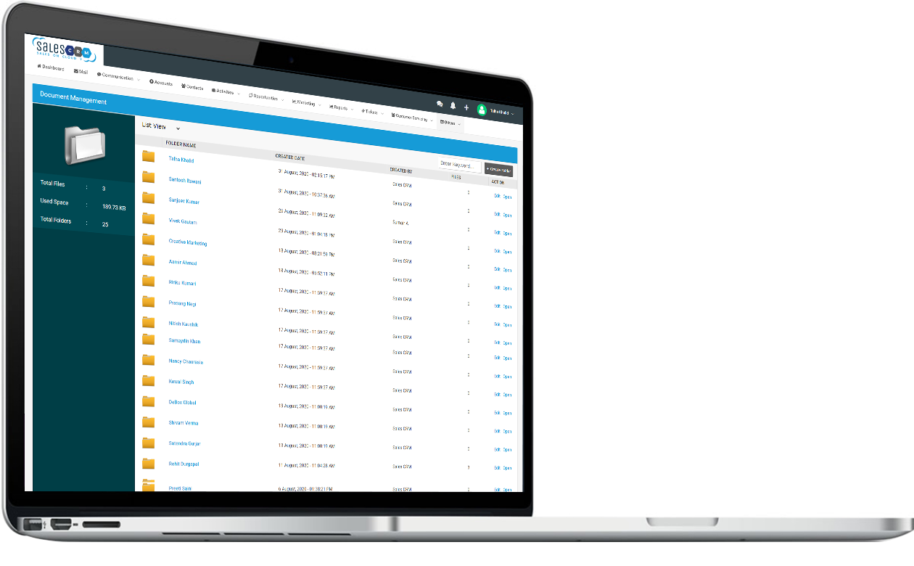
DOCUMENT MANAGEMENT
Document Management acts as an Extranet of the company where all latest formats and documents can be uploaded, viewed, downloaded, etc.
Folders with required rights to users helps in giving them Information Access 24 x 7.
Department wise Folders facilitates the cross — functional coordination.
Easy Retrievals and Better Collaboration increases the efficiency of work.
WWW.DEBOXGLOBAL.COM

Slide 15
+91 9 910 910 910 | INFO@DEBOXGLOBAL.COM
WWW.DEBOXGLOBAL.COM

